Slide 1

Troubleshooting – PART 1
Customer Info
VM Connector
Naresh Saladi

Slide 2
How To ??
Execute App in Debug Mode – Understand flow and objects
Performed Memory Profiling to assess memory footprint
Analyzed heap dump and garbage collections
Identified timing between publishing and consuming messages

Slide 3
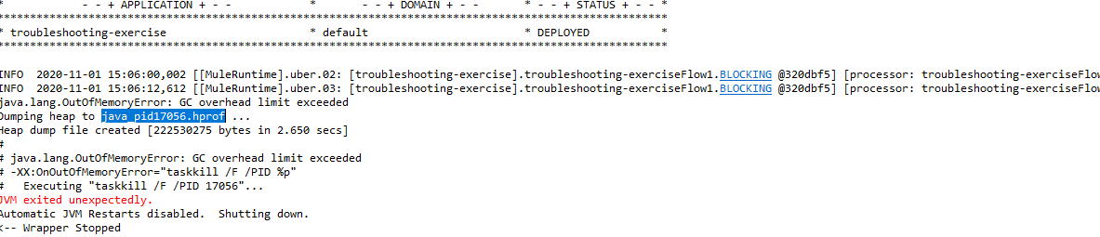
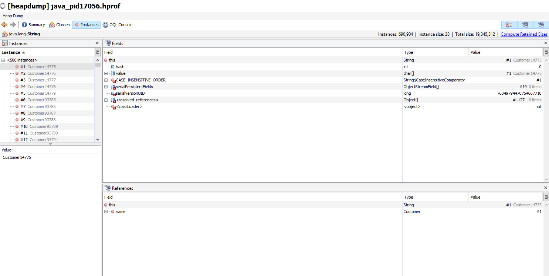
Heap Dump- YourKit

Slide 4
Root Cause Analysis
Garbage Collection not running frequently with default ParallelGC
Multiple Customer Objects with duplicate string created
Customer Retrieve and publishing at 1 second interval
Consumption at 5 second interval and timeouts after 5 seconds(drops)
Requests dropping when server crashes

Slide 5
Suggested Approach
Add G1GC Garbage Collector and use String Deduplication
Reduce consumption interval from 5 seconds to 1 second along with timeout 1 second
Changed queue type from transient to persistent
Set Payload to null to remove dangling references
Alternate design from Publisher-Consumer pattern to Publisher-Listener if requirement has no requirements for conditional consumption and asynchronous behavior
Alternate design to leverage flow references if processing within same application

Slide 6
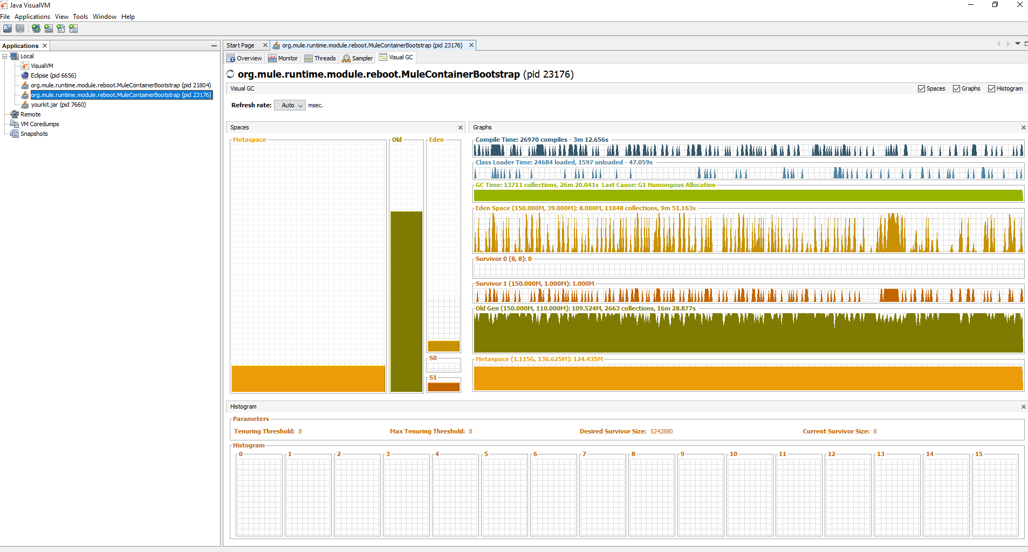
Post-Changes Capture
-Xmx150m -Xms150m -M-XX:-UseBiasedLocking -M-Dfile.encoding=UTF-8 -M-XX:+UseG1GC -M-XX:+UseStringDeduplication

Slide 7
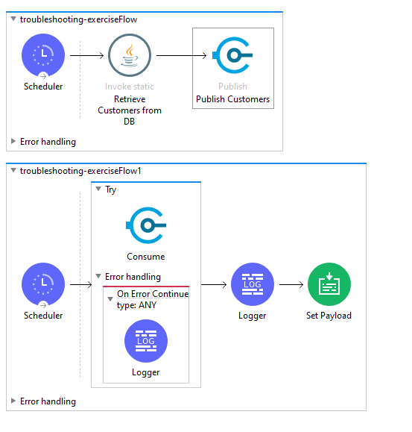
Flow Design - Solution

Slide 8
API – Integrations – Part2
Social API– App Network
Anypoint Platform/Studio
Naresh Saladi

Slide 9
Social API – Business Case
Multiple social-media platforms
Twitter,Facebook,Instigram,Youtube,WhatsApp
Multiple versions of APIs for each platform
Zero integration between platforms

Slide 10
Arch & Design Concepts
API First Design Approach
API Led Connectivity
Three Layer Architecture
Design Patterns – Industry Standards

Slide 11
Logical Architecture

Slide 12
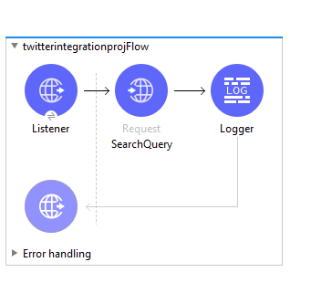
Flow Design – System APIs

